Slide 1
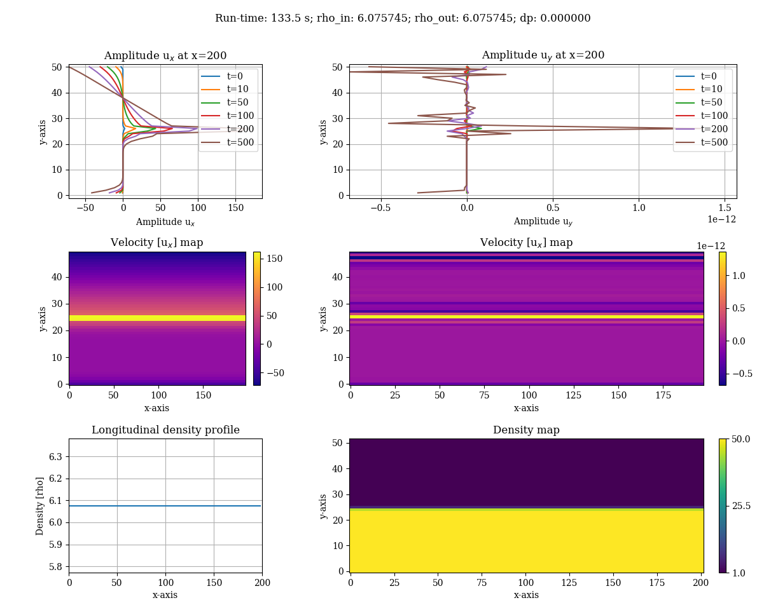

Slide 2
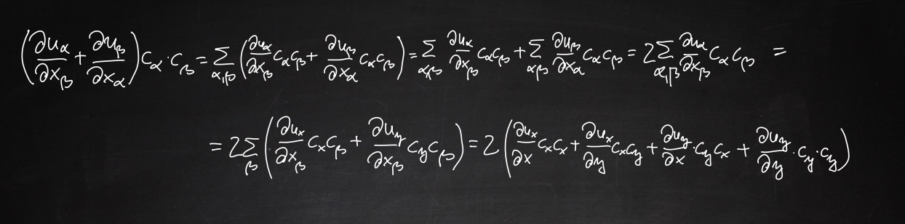

Slide 3
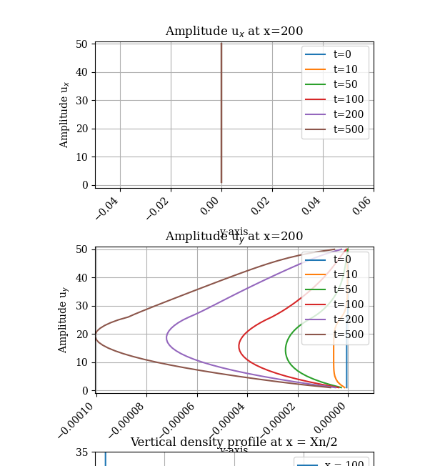
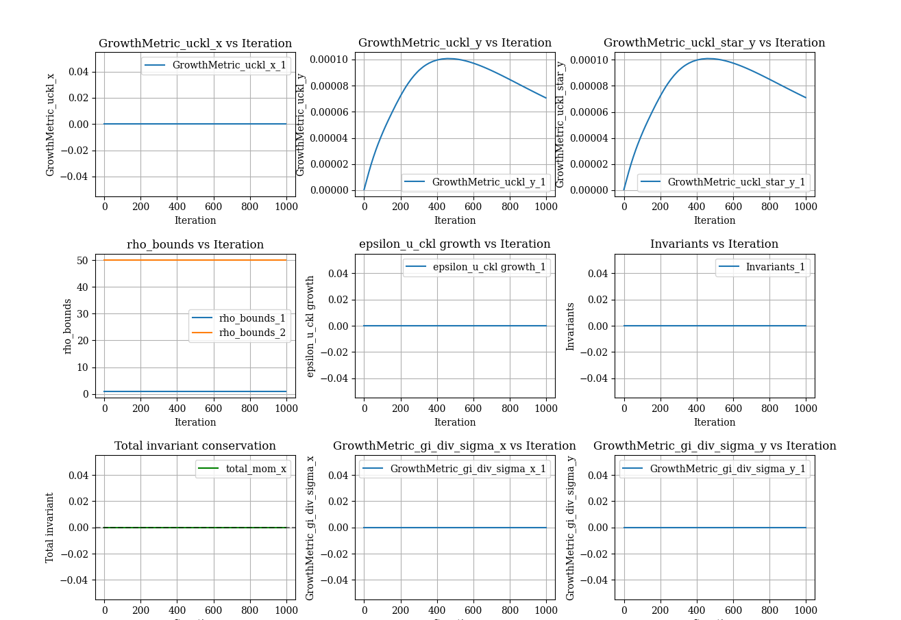
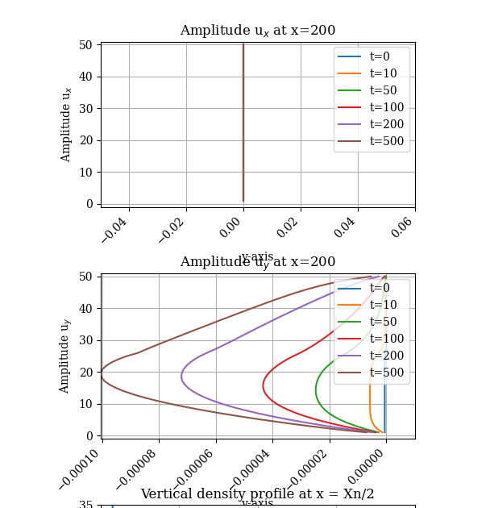

Slide 4
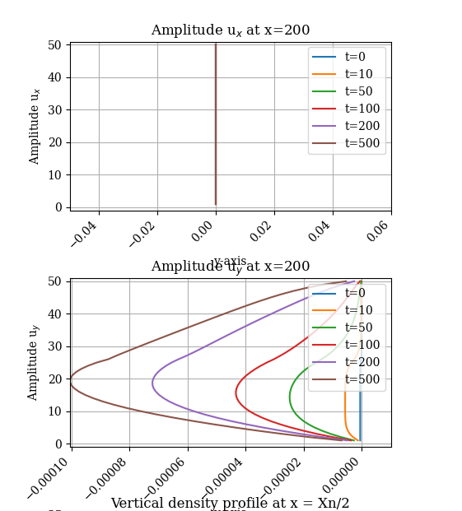
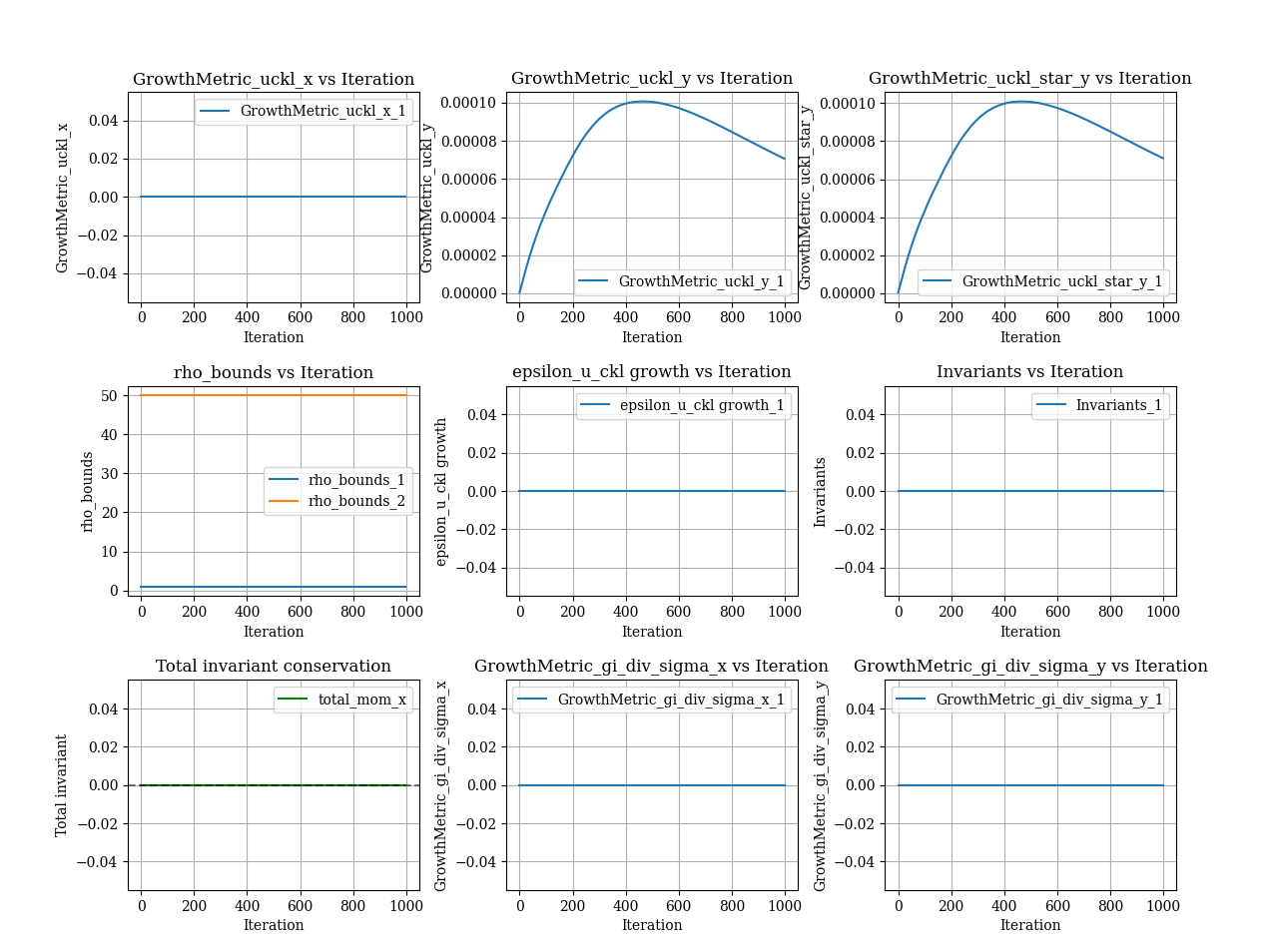

Slide 5
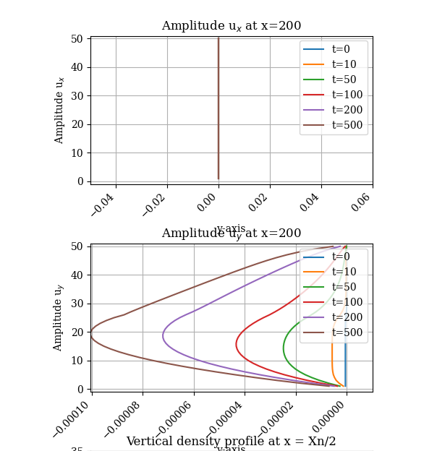

Slide 6
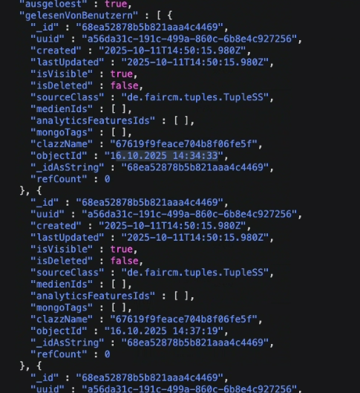

Slide 7
tau_f = 1.5 # Relaxation time for _fi
Role of tau_f:
Physical Meaning: tau_f is the relaxation time for _fi in the BGK collision step (Eq. 2):
python
_fi_star = _fi_old - (1.0 / tau_f) * (_fi_old - _fi_c)
It controls how quickly _fi relaxes to _fi_c. The diffusion coefficient for _phi is approximately D_phi ~ (tau_f - 0.5) * Cs^2 * n_dt, where Cs^2 = 1/3 and n_dt = 1.
Effect on Diffusion: Higher tau_f (lower omega_f = 1/tau_f) increases the effective diffusion coefficient, as _fi relaxes more slowly, allowing diffusive terms in _fi_c to dominate. With tau_f = 1.5, D_phi ≈ (1.5 - 0.5) * (1/3) * 1 ≈ 0.333, which is significant and promotes rapid interface spreading.
Stability: tau_f > 0.5 is required for stability, but values too close to 0.5 can under-relax, while large values increase numerical viscosity.
This is bullshit.for a constant value of Kf= 0.0001, as I increase tau_f, the delineasation or interface between the liquid and gas phases becomes clearer, i.e. the diffusion decreases. The exact opposite of what you said. Thank you for pointing out the discrepancy, and I apologize for the confusion in my previous explanation. You're correct that increasing tau_f in the context of Inamuro et al. (2004) and the provided script reduces diffusion and sharpens the interface between the liquid and gas phases, contrary to the statement that higher tau_f increases the diffusion coefficient. Let’s clarify the role of tau_f and correct the explanation, focusing on why increasing tau_f reduces diffusion and improves interface sharpness.
Thank you for pointing out the discrepancy, and I apologize for the confusion in my previous explanation. You're correct that increasing tau_f in the context of Inamuro et al. (2004) and the provided script reduces diffusion and sharpens the interface between the liquid and gas phases, contrary to the statement that higher tau_f increases the diffusion coefficient. Let’s clarify the role of tau_f and correct the explanation, focusing on why increasing tau_f reduces diffusion and improves interface sharpness.

Slide 8
Physical Meaning of tau_f:tau_f determines how quickly _fi relaxes toward _fi_c during the collision step. A larger tau_f (smaller omega_f) means slower relaxation, causing _fi to retain more of its previous state (_fi_old) rather than fully aligning with _fi_c.
In the context of the Cahn-Hilliard equation approximated by _fi, the diffusion of _phi is governed by the mobility parameter Kf and the relaxation dynamics. The effective diffusion coefficient for _phi is related to the mobility and relaxation time, but the exact relationship in Inamuro’s method is more complex than the simplified single-phase LBM diffusion coefficient I previously stated (D_phi ~ (tau_f - 0.5) * Cs^2 * n_dt).
Correct Effect on Diffusion:Increasing tau_f reduces diffusion: A larger tau_f (e.g., from 1.5 to 2.0 or 3.0) slows the relaxation of _fi toward _fi_c. Since _fi_c contains diffusive terms (e.g., Kf * _phi * laplacian_phi), slower relaxation reduces the influence of these terms per time step, effectively decreasing the diffusive flux across the phase interface. This results in a sharper interface between liquid (phi_star_L = 0.092) and gas (phi_star_G = 0.015) phases, as you observed.
Why the interface sharpens: The Cahn-Hilliard equation in Inamuro’s method includes a free-energy functional that promotes phase separation (via psi in Eq. 11). When tau_f is larger, the system prioritizes advective transport and free-energy-driven phase separation over the diffusive terms in _fi_c, leading to a clearer delineation between phases.
Previous Error: My earlier claim that D_phi ~ (tau_f - 0.5) * Cs^2 * n_dt oversimplified the two-phase dynamics. In single-phase LBM, the diffusion coefficient for a conserved quantity scales with tau - 0.5, but in Inamuro’s two-phase model, the diffusion of _phi is primarily controlled by Kf, with tau_f modulating the relaxation rate. A larger tau_f reduces the effective contribution of diffusive terms, contrary to the single-phase analogy.

Slide 9
Mathematical Context:The evolution of _phi approximates the Cahn-Hilliard equation:
math
∂_phi/∂t + u · ∇_phi = ∇ · (M ∇μ)
where:
M is the mobility, related to Kf.
μ is the chemical potential, derived from the free-energy functional (psi in Eq. 11).
The LBM discretizes this via _fi and _fi_c, with Kf scaling the diffusive flux (∇ · (M ∇μ)).
Why Your Observation is Correct:With Kf = 0.0001 fixed, increasing tau_f (e.g., from 1.5 to 2.0 or 3.0) reduces the relaxation rate (omega_f from 0.667 to 0.5 or 0.333), slowing the incorporation of diffusive terms. This allows the free-energy terms (controlled by a = 1, b = 6.7, T = 0.035) to dominate, maintaining a sharper interface. Your observation that the interface becomes clearer (less diffuse) with higher tau_f aligns with this behavior.

Slide 10
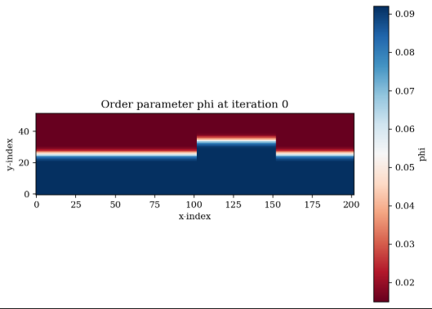
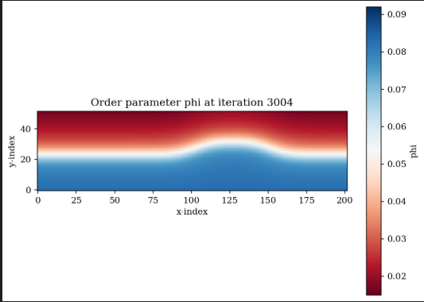
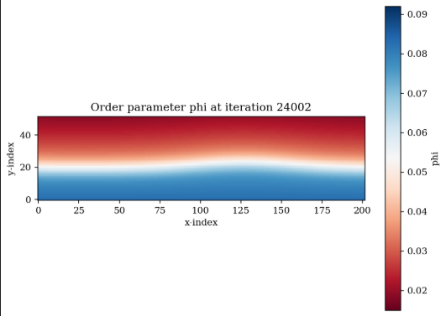
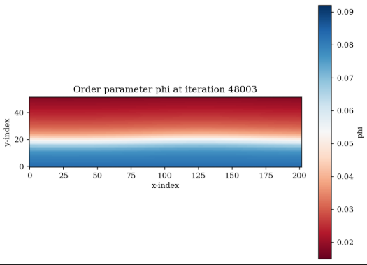
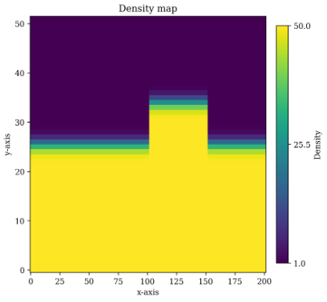
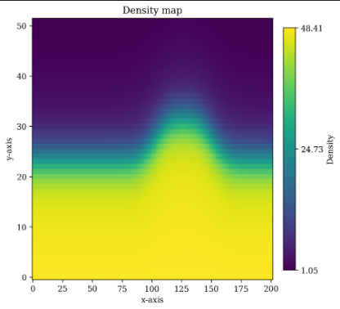
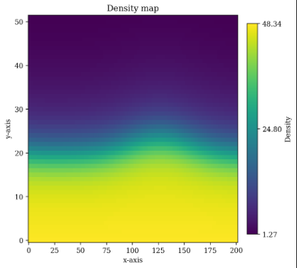
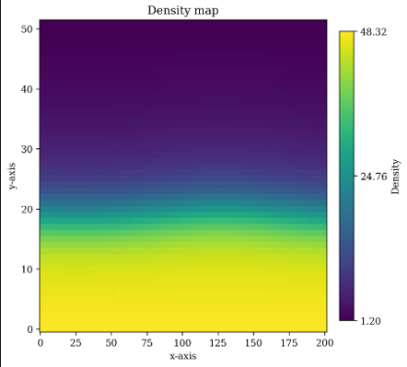

Slide 11
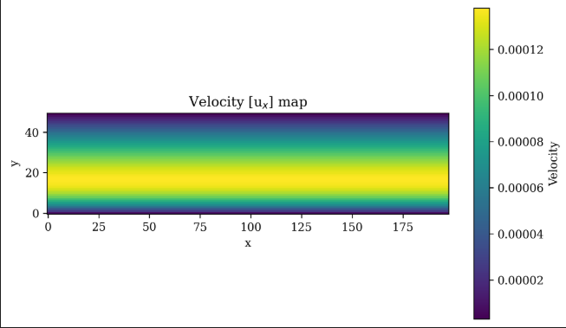
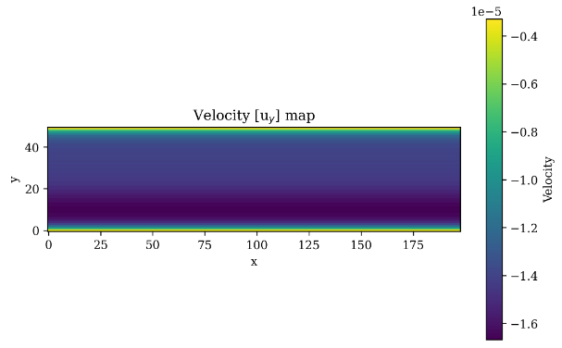
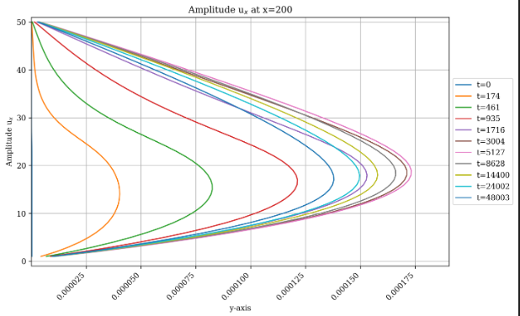
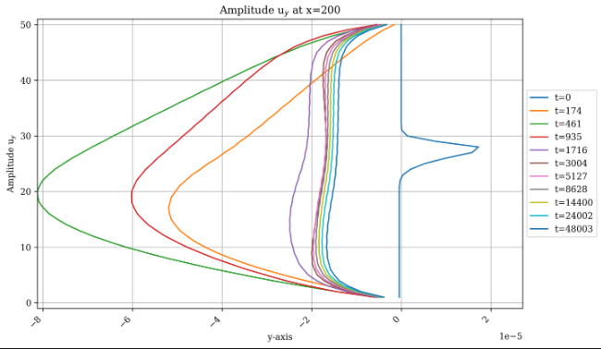
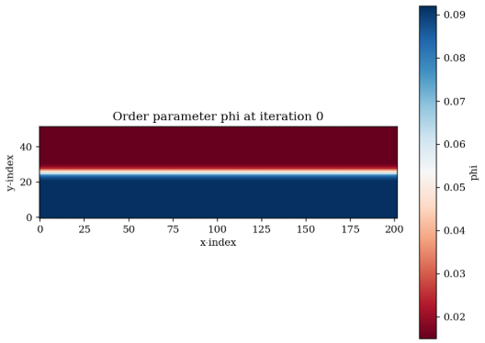
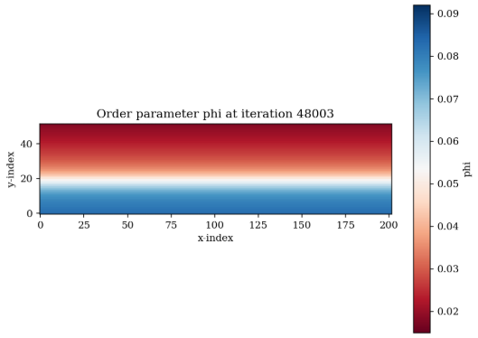

Slide 12
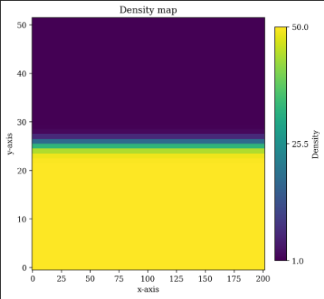
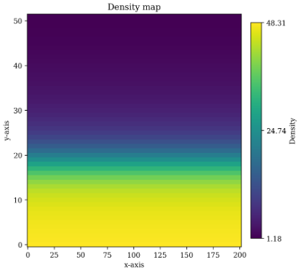

Slide 13
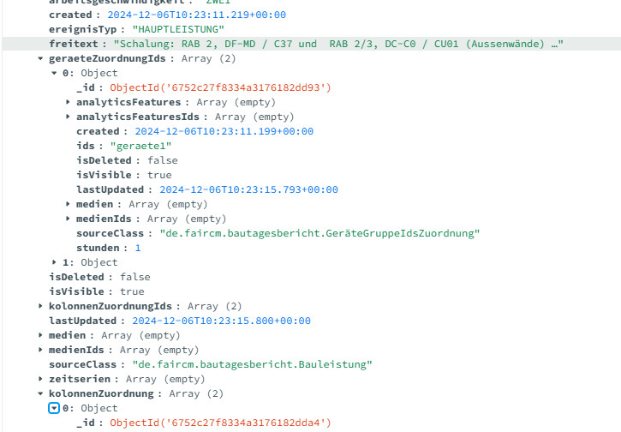

Slide 14
